Slide 1

Area-Wise Hotel Price Analysis Using Web Scraping & EDA
Name : Mandla Ashok
Batch :456

Slide 2
Agenda
Introduction & Business Problem
Objectives of the Project
Data Collection (Web Scraping)
Dataset Overview & Data Cleaning
Exploratory Data Analysis (EDA)
Hypothesis Testing
Key Insights & Business Recommendations
Challenges Faced
Conclusion

Slide 3
INTRODUCTION
The project collects data from online booking platforms using web scraping.
Exploratory Data Analysis(EDA) is used to study hotel pricing patterns.
The goal is to understand how prices vary with location,ratings reviews, and room types..
Python tools like Selenium,Pandas, and Matplotlib are used.
The analysis helps travelers identify affordable hotel areas. .
The project supports smarter and cost-effective booking decisions.

Slide 4
BUSINESS PROBLEM
Travelers visiting unfamiliar cities often struggle to find affordable hotels because prices vary widely across different areas of the same city. Existing booking platforms focus mainly on ratings and reviews, which do not clearly indicate whether a hotel is budget-friendly. Additionally, there is no structured, area-wise hotel pricing dataset that helps users identify affordable zones. Due to this lack of visibility and data-driven insights, travelers frequently overpay for accommodation.

Slide 5
OBJECTIVES
Scrape hotel data from Booking.com using Selenium.
Clean and organize the scraped data.
Analyze price variations across locations.
Study relationships between price, rating, reviews, and room types..
Identify affordable and overpriced hotel areas.
Provide actionable insights for travelers.

Slide 6

The Dataset & Target Variable
Source: https://www.Booking.com/
Scope: Hotels in Hyderabad (selected dates) .
Key Features:
Hotel Name – Name of the hotel or accommodation listed on the booking platform.
Location – Area or locality within the city where the hotel is situated.
Rating – Average customer rating that reflects overall guest satisfaction.
Review Count – Total number of customer reviews submitted for the hotel.
Discounted Price – Current price offered after applying discounts or offers.
Original Price – Actual listed price of the hotel before any discounts.

Slide 7








TOOLS USED
selenium
python

Slide 8
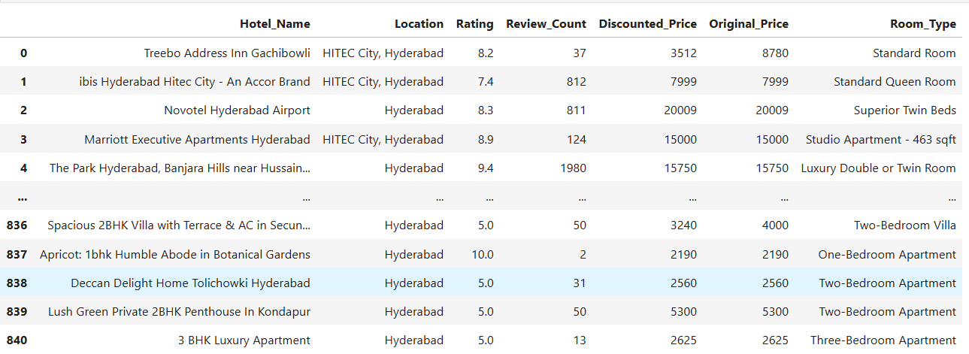
Scraped Hotel Booking Dataset

Slide 9
Data Cleaning Steps
Removed missing and duplicate records.
Converted prices and reviews into numeric format.
Standardized location and room type values.
Handling missing ratings and prices.
Final dataset ready for analysis..

Slide 10
PART 1: UNIVARIATE ANALYSIS

Slide 11
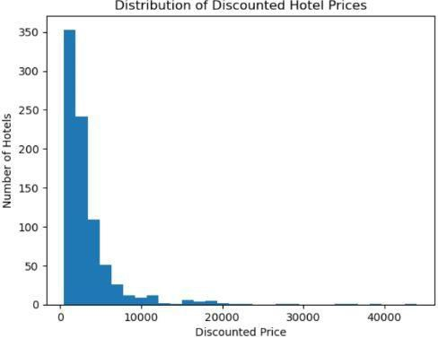
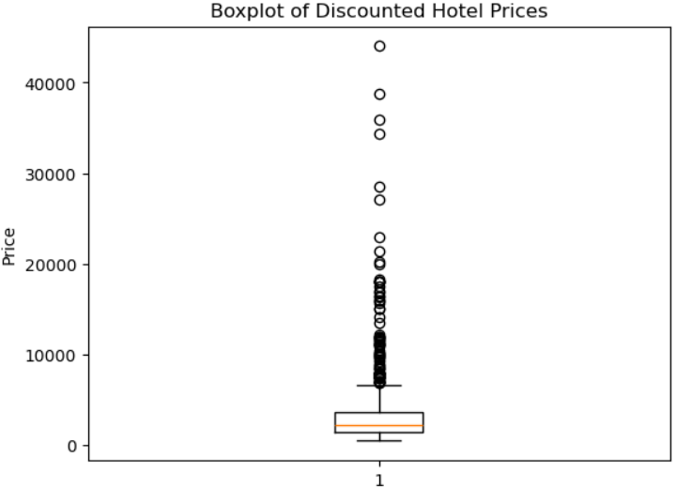
Price Distribution Analysis
Insights:
Majority of hotels fall under affordable to mid-range prices.
A small number of luxury hotels act as price outliers.
Hotel ratings are generally high, indicating good overall service quality.
Price distribution shows high variability across hotels.

Slide 12
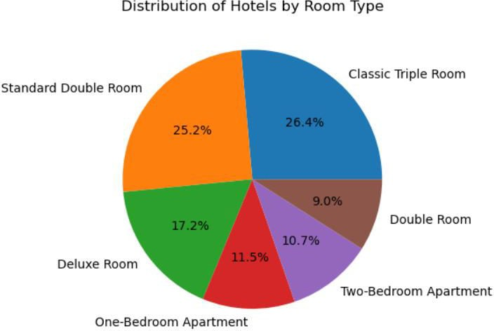
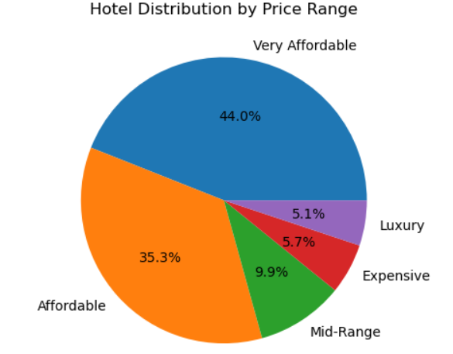
Key Hotel Metrics Distribution
High-rated hotels are not always expensive.
Same-rated hotels show wide price variation across locations.
Location plays a more dominant role than ratings in price determination
Review count does not strongly influence hotel pricing.

Slide 13
PART 2: BIVARIATE ANALYSIS

Slide 14
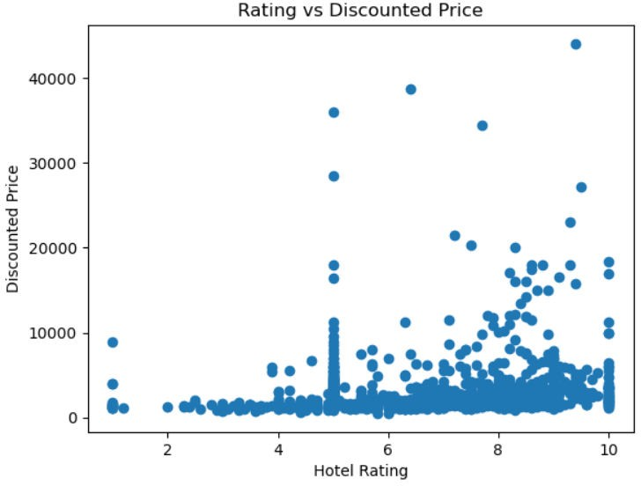
Critical Performance Relationships
Insights
Review score vs price analysis shows limited direct dependency.
Hotels with similar ratings charge different prices based on area.
Indicates that customer satisfaction alone does not define pricing.
Location and demand factors dominate performance-based pricing.

Slide 15
PART 3: MULTIVARIATE ANALYSIS

Slide 16
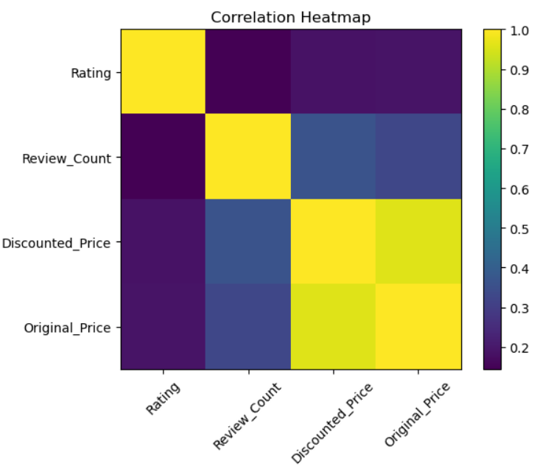
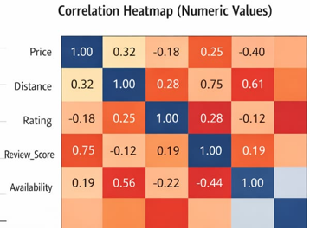
Market Segmentation Analysis
Insights:
Hotels grouped into budget, mid-range, and premium segments.
Segmentation reveals clear pricing and quality patterns
Affordable hotels exist even in premium locations.
Enables targeted recommendations for different traveler types.

Slide 17
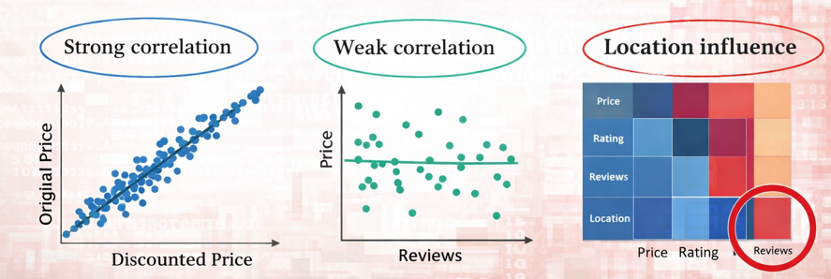
Multivariate Correlation Patterns
Correlation Insights:
Strong correlation between original and discounted prices.
Weak correlation between review count and price.
Location emerges as the strongest pricing driver.
ANOVA Insights:
Statistically significant price differences across room types.
Confirms room category as an important pricing factor.

Slide 18
Hypothesis Test 1: Price vs Room Type (ANOVA)
H₀ (Null Hypothesis):
There is no significant difference in hotel prices across different room types.
H₁ (Alternative Hypothesis):
There is a significant difference in hotel prices across different room types.
Test Used: One-Way ANOVA
Significance Level (α): 0.05
Result & Insight:
P-value < 0.05 → Reject H₀

Slide 19
Hypothesis Test 2: Price vs Location (ANOVA)
H₀ (Null Hypothesis):
Hotel prices do not differ significantly across locations.
H₁ (Alternative Hypothesis):
Hotel prices differ significantly across locations.
Test Used: One-Way ANOVA
Significance Level (α): 0.05
Result & Insight:
P-value < 0.05 → Reject H₀

Slide 20
Hypothesis Test 3: Price vs Review Score (Correlation Test)
H₀ (Null Hypothesis):
There is no significant relationship between hotel price and review score.
H₁ (Alternative Hypothesis):
There is a significant relationship between hotel price and review score.
Test Used: Pearson Correlation
Significance Level (α): 0.05
Result & Insight:
Weak correlation → Fail to reject H₀

Slide 21
Hypothesis Test 4: Price vs Review Count (Correlation Test)
H₀ (Null Hypothesis):
Hotel price is not influenced by the number of reviews.
H₁ (Alternative Hypothesis):
Hotel price is influenced by the number of reviews.
Test Used: Pearson Correlation
Significance Level (α): 0.05
Result & Insight:
Very weak correlation → Fail to reject H₀

Slide 22
Key Business Insights & Recommendations
Location is the primary driver of hotel pricing.
Affordable hotels exist even in premium areas..
Travelers overpay due to lack of pricing awareness.
.
Discounts represent real market prices.
Platforms should recommend hotels using price-to-rating ratio..

Slide 23
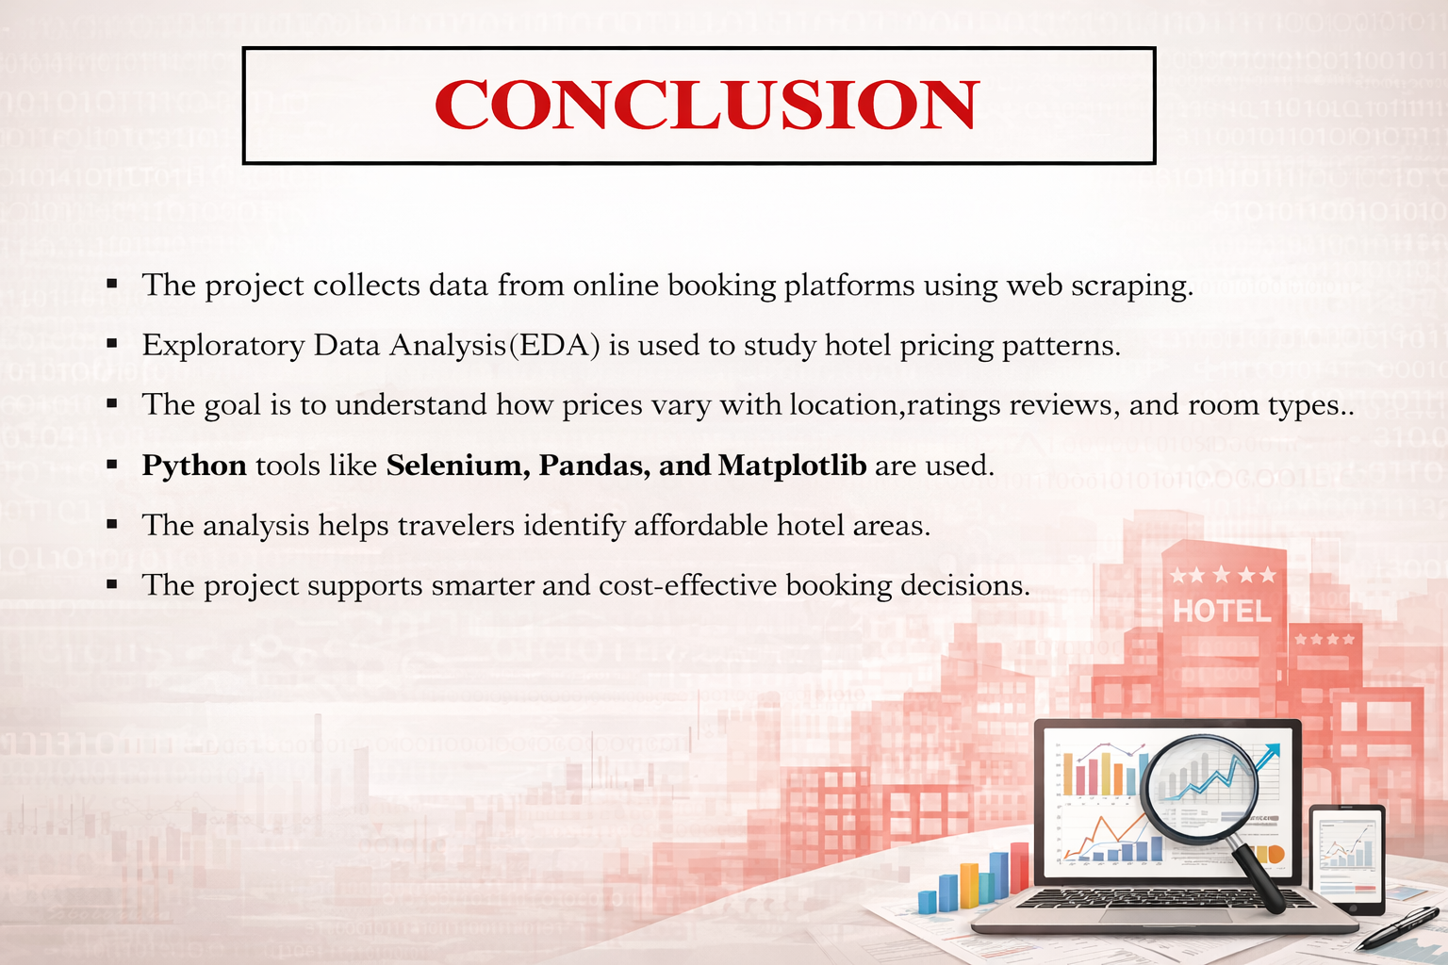

Slide 24
Thank you

